Slide 1
Exercise 6 DENSITY MATRICES FORMALISM
QUANTUM INFORMATION AND COMPUTING course 2021/2022
Alessandro marcomini (2024286)
Prof. Simone montangero

Slide 2

Exercise goals
Consider a quantum system formed by N subsystems (spins, atoms, particles etc..) each described by its wave function $ψ_{i}$ ∈ $ℋ^{D}$where $ℋ^{D}$ is a D-dimensional Hilbert space.
Write a Fortran code to describe such a system (N-body non interacting, separable pure state) and a general N-body pure wave function $ψ$∈ $ℋ^{D^{N}}, \text{c}\text{omment}\text{ing} \text{their} \text{efficiency}\text{. }$
Given N = 2, write the density matrix of a pure state $ψ$, $ρ=|ψ><ψ|$
Given a generic density matrix in $ℋ^{D^{2}}$ compute the reduce density matrix of either the left or the right system, e.g. $ρ_{1}$ = ${Tr}_{2}$ ρ.
Test the functions described before (and all others needed) on two-spin one-half (qubits) with different states.

Slide 3

IN THEORY…
Many-body quantum state: $|α_{1}> ⊗|α_{2}>$ $⊗\left(…\right)⊗|α_{N}> ≡|α_{1}α_{2}{…α}_{N}>$
Since $α_{i}=0,1,…D−1$, integer notation: $x= α_{1}D^{N−1}+\left(…\right)+$ $α_{N−1}D+$ $α_{N}$
For a bipartite system $|αβ>$: ${{(ρ}_{A})}_{ij}$ = ${{(Tr}_{B}ρ)}_{ij}$ = $Σ_{β}<α_{i}β|ρ|α_{j}β>$ where $|α_{j}β> =|α_{j}D+β>$, $β=0,…D−1$ ${{(ρ}_{B})}_{ij}$ = ${{(Tr}_{A}ρ)}_{ij}$ = $Σ_{α}<{αβ}_{i}|ρ|{αβ}_{j}>$ where $|{αβ}_{j}> =|αD+β_{j}>$, $α=0,…D−1$ Therefore, easy access to $ρ$ elements according to integer index to sum onto
To define a generic many-body quantum state: need to specify all the density matrix: $O(D^{N})$
To define a separable state: need $D$ coefficients per subsystem (total $O(DN)$)

Slide 4
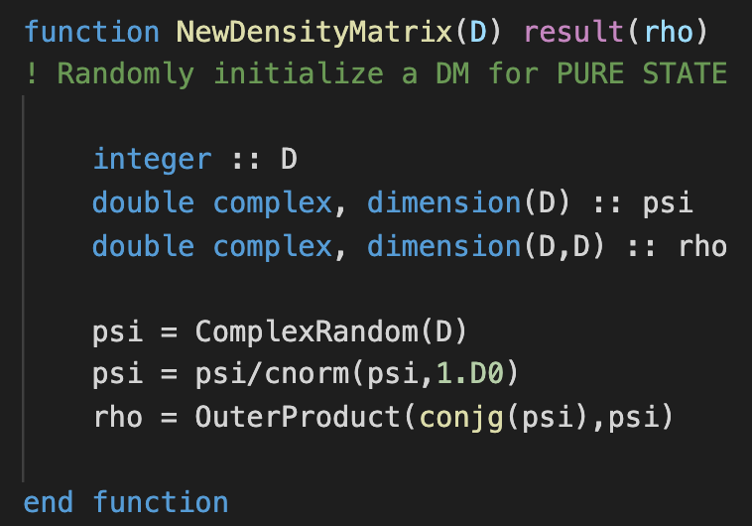
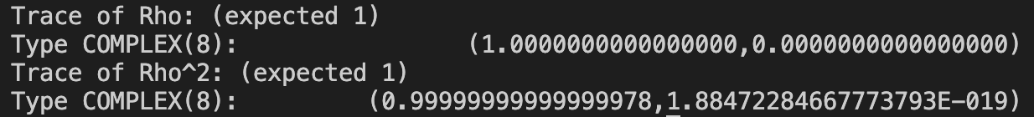



CODE DEVELOPMENT: $ρ$
Note: variable D $≡D^{N}$
Define $ρ$as projector of pure state (outer product of $ψ^{∗},ψ$)
Check purity: $Tr\left(ρ\right)=Tr\left(ρ^{2}\right)=1$

Slide 5
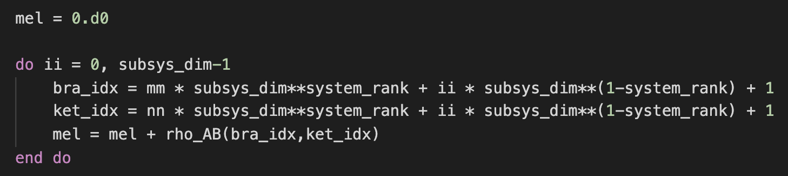
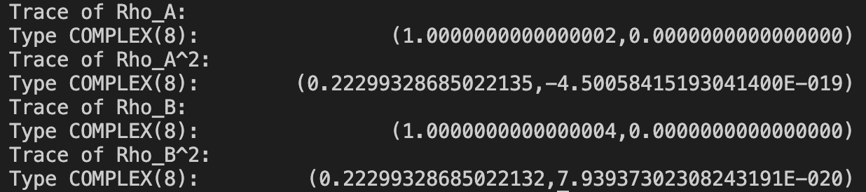



CODE DEVELOPMENT: reduced $ρ$, N=2, large D*
*up to 100, time $≈5s$
Generate random density matrix for whole system
Update each reduced density matrix element summing al suitable indexes
Check on reduced $ρ$: expected unitary trace
In general, non-pure states: $Tr(ρ^{2})≠1$
Try for different values of size for system

Slide 6
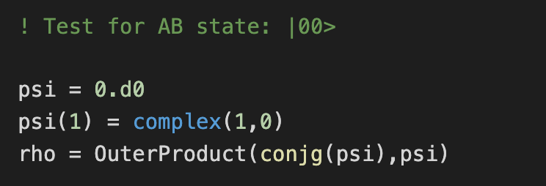
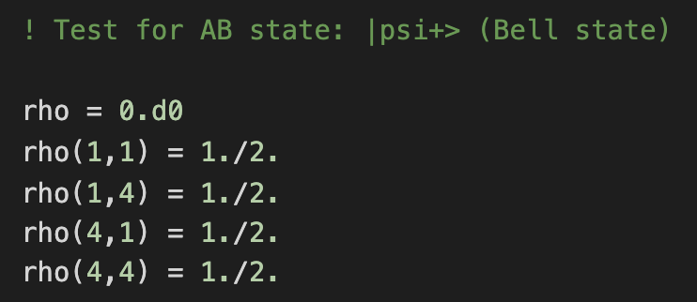
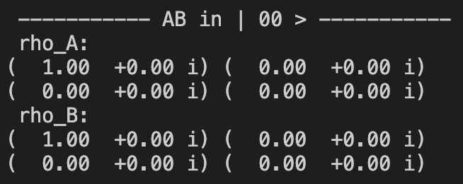
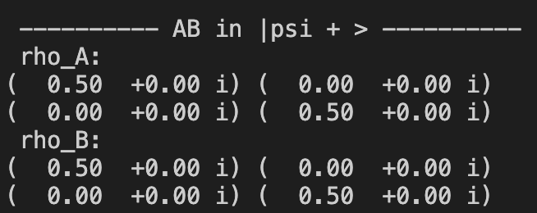


CODE DEVELOPMENT: known qubit states
PURE, separable state:
$|ψ>_{AB}$ = $|00>_{AB}$
Pure, MAXIMALLY entangled state: $|ψ>_{AB}$ = $1/{\sqrt{2}}(|00>_{AB}+$ $|11>_{AB})$
Expected pure state
Expected maximally mixed state

